Slide 1
BST 270 Reproducible Data Science
Heather Mattie
hemattie@hsph.harvard.edu

Slide 2
What does ‘reproducible research’ mean to you?
Why do you think it’s important (or not)?
What do you think making your research reproducible entails?

Slide 3
Reproducible
A range of best practices for quantitative research including management and sharing of data and computational methods. More formally, an experiment can be considered "reproducible" if a different research team can obtain its input data and computational tools, and rerun the same methods to obtain the same result.

Slide 4
Replicable
A prior study being duplicated using the same procedures or concept, but with new data. Replicability guarantees reproducibility, but not the converse.

Slide 5
Course Objectives
Describe the fundamentals and importance of reproducible research
Assess the reproducibility of others’ research
Create a fully reproducible research project
Develop new methods and tools for reproducible research

Slide 6
Course Modules
1 – Introduction to the teaching team and course
2 – Fundamentals of reproducible research
3 – Case studies in reproducible research
4 – Data provenance
5 – Statistical methods for reproducible science
6 – Computational tools for reproducible science

Slide 7
Grading
Project proposal – 10%
Class participation and peer critiques – 55%
Final project – 25%
Final project presentation – 10%

Slide 8
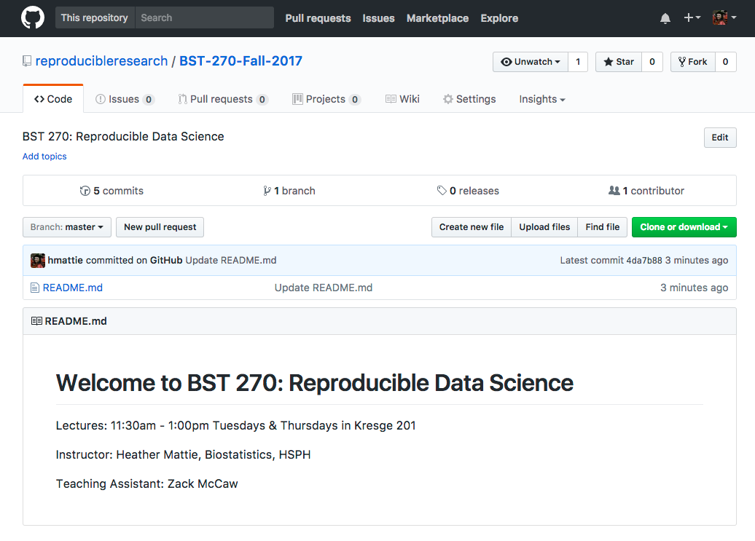
Course Repository
https://github.com/reproducibleresearch/BST-270-Fall-2017

Slide 9
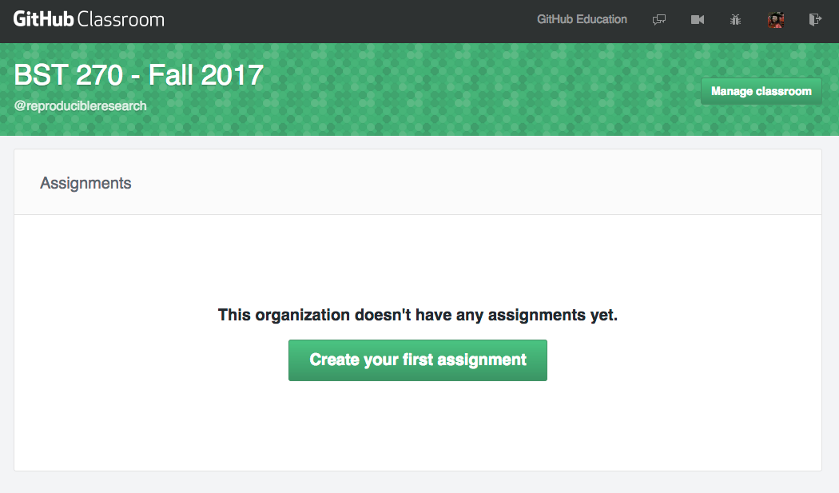
Individual Repositories

Slide 10
TA
Zack McCaw
4th year Biostats doctoral student
zmccaw@g.harvard.edu
Office hour TBD (no lab)

